Slide 1
Team ranking prediction using partial order relation of rough sets and cluster analysis of multivariate statistics
Relaxed style presentation
18.07.24
Ding Yeming

Slide 2
Abstract
Fuzzy mathematics rough set dominance analysis and cluster analysis can objectively reflect the comprehensive strength of the team.
This report takes the Euro 2024 teams as the object set and the football technical ability index as the attribute set, and makes statistics on the match data through the data records on the official website to analyze the ability index of each team. Using fuzzy mathematics to reduce the set of attributes, combined with MATLAB assisted calculation, the teams are sorted and classified, and the ranking of the participating teams is predicted.
Based on the methodology presented in this report, the favourites for the Euro 2024 championship can be predicted. It also provides the basis for the adjustment of tactics of the Chinese men's football team in the Asian 18-strong preliminary match of the 2026 US-Canada-Mexico World Cup.

Slide 3

Backdrop
Until 2 July 2024, the 24 participating teams were divided into six groups for the group stage, through 36 group games and eight eighth finals have been determined.
This report is based on the data of the eight teams participating in the quarterfinals in the group stage to conduct average technical processing statistics, and the use of rough set knowledge and matlab cluster analysis to analyze the data of these eight teams to predict the championship favorites of this European Cup.

Slide 4
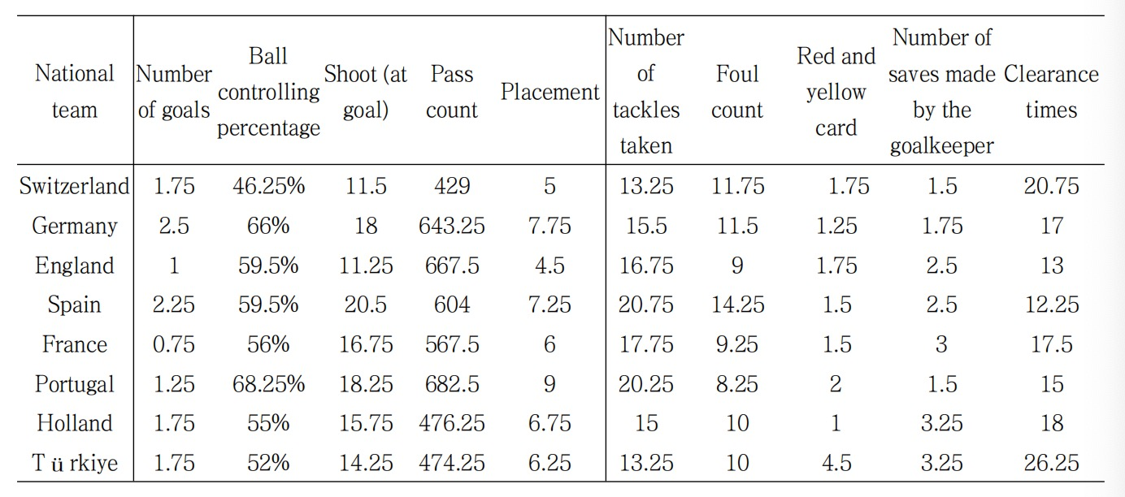
Statistical calculation of average data per game
According to the statistics on the official website of the European Championship (as of July 2, 2024), the statistical indicators for this analysis were determined and the following table of average match data was obtained (UEFA, 2024)

Slide 5
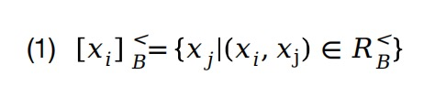
Methods A: method for the dominance analysis of rough sets based on the total ordering of partial order relation
Theory and formula
Rough set method is to establish the dominance relation on the partial order relation, transform the information system into the dominance relation model, and pass the relation model
Type gets the order between objects. By calculating the dominance degree of each object and the overall dominance degree, the ranking can be given more accurately。
Formula 1

Slide 6
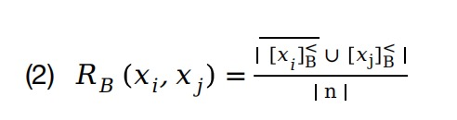
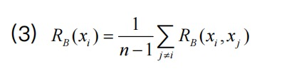
Methods A: method for the dominance analysis of rough sets based on the total ordering of partial order relation
Formula 2
Formula 3

Slide 7
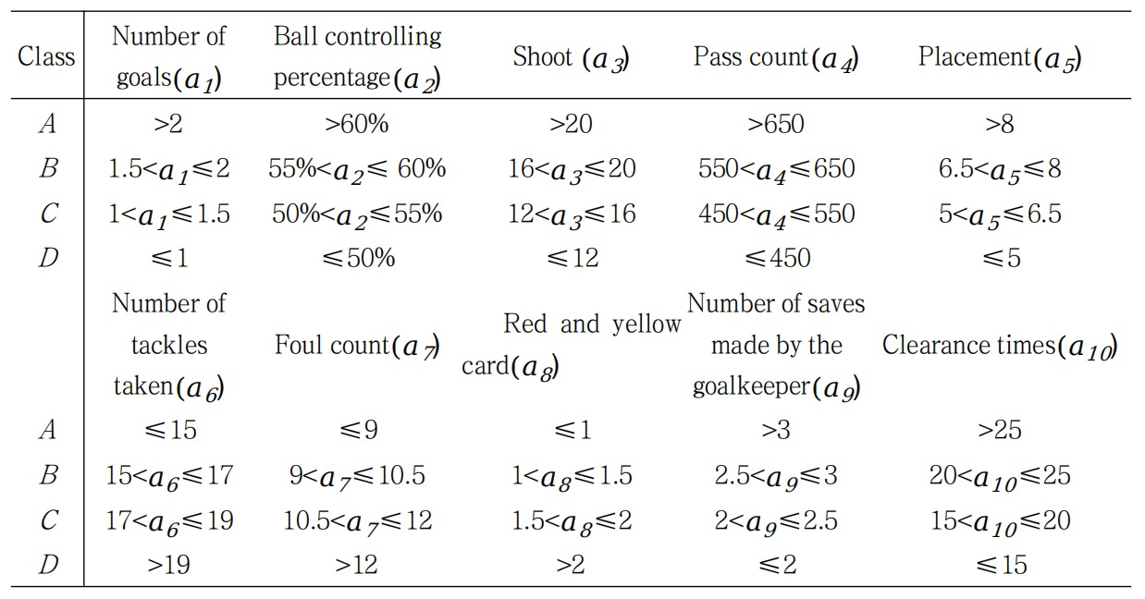
National team data advantage ranking steps and results
Let's define U ={x1,x2......x8} indicates the 8-team object set of the European Cup, A ={a1,a2.....a10} is a set of attributes.
Step 1: Establish the following classification indicators of the information system, among which the index level relationship:A>B>C>D

Slide 8
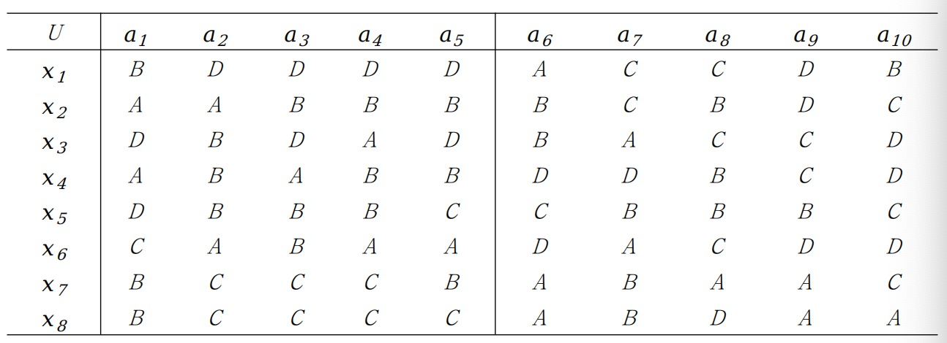
National team data advantage ranking steps and results
Step 2: According to the division indicators in Table 2, the original data in Table 1 is converted into the following table of average data information system. a1,a2,a3,a4,a5 is used as the offensive indicator of the team . a6, a7, a8,a9,a10 is used as the defensive indicator of the team.

Slide 9
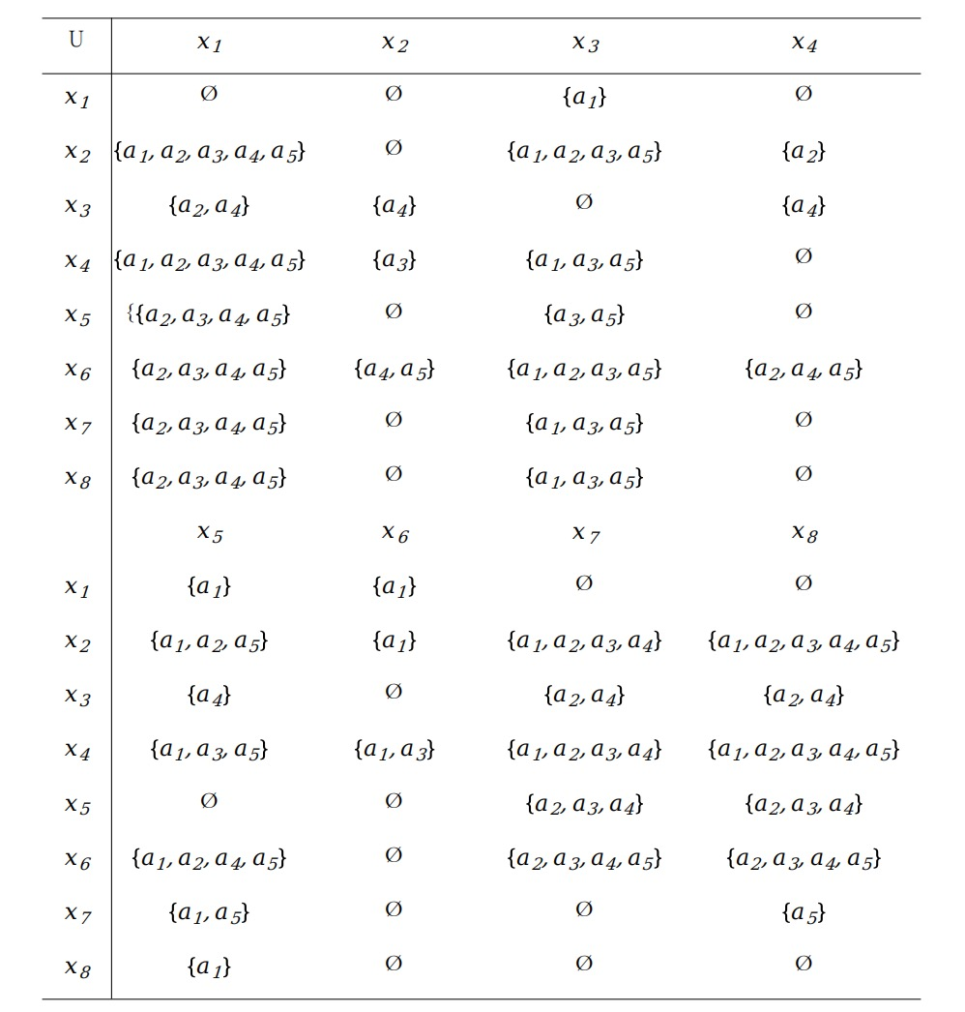
National team data advantage ranking steps and results
Step 3: Analyze metrics.
After analyzing the attack ability index, the following attack ability identification matrix can be obtained by rough set method of partial order relational information system.

Slide 10
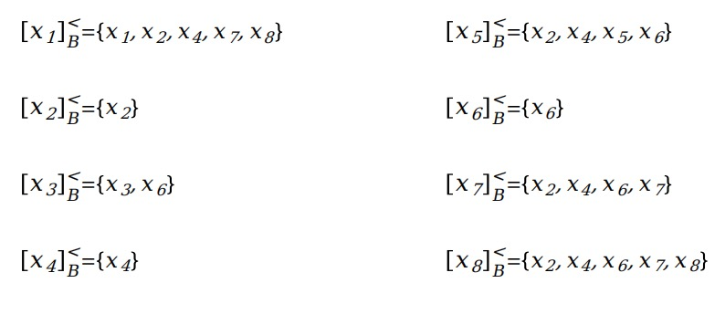
National team data advantage ranking steps and results
Step 4: Attribute reduction.
According to the relationship between offensive ability identification matrix and rough set in Table 4, the superiority classes of reduced attribute set are obtained:

Slide 11
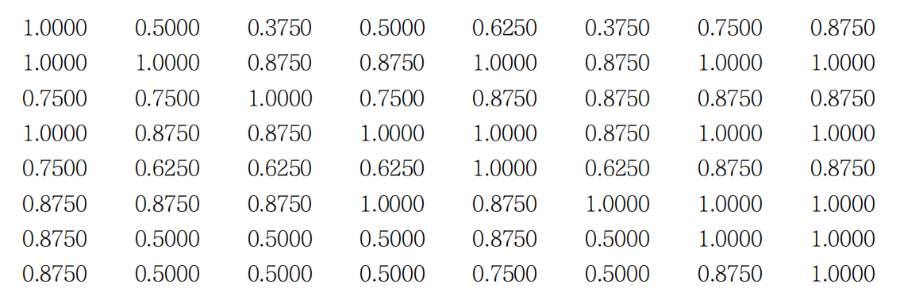
National team data advantage ranking steps and results
Step 5: Data processing First, according to formula (2), the advantage matrix between objects is obtained by using MATLAB data processing:

Slide 12
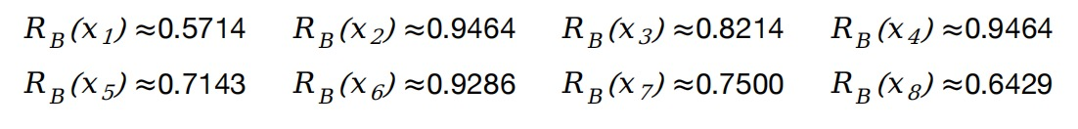
National team data advantage ranking steps and results
Step 5: Data processing Then, according to formula (3), the comprehensive superiority degree of the team's offensive ability is calculated:
Sort objects from largest to smallest as：x2=x4>x6>x3>x7>x5>x8>x1
In the same way, you can calculate the overall superiority of the team's defensive ability.
The following dominance ranking table is obtained:

Slide 13
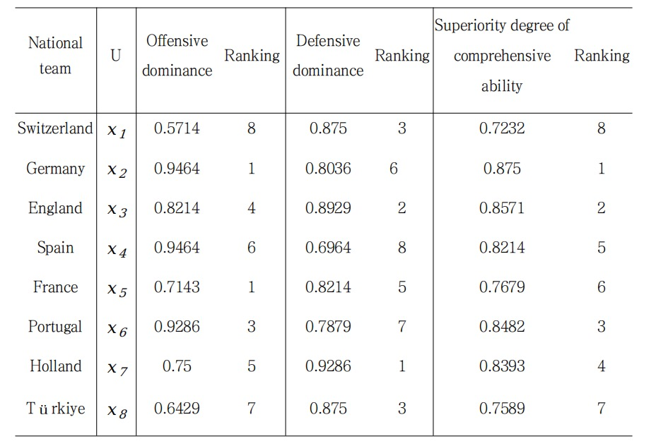
National team data advantage ranking steps and results
It can be directly seen from Table 5 that Germany ranks first in the evaluation of offensive ability, while the Netherlands ranks first in defensive superiority. Germany, England, Portugal and the Netherlands are at the top of the overall rankings

Slide 14
Method B: Fuzzy ISODATA Clustering Algorithm (Cluster analysis method based on objective function)
The theoretical basis of fuzzy cluster analysis is fuzzy equivalence relation. When the domain U is a finite set, the ordinary equivalence relation is represented by an equivalent Boolean matrix, and the fuzzy equivalence relation is represented by a fuzzy equivalent matrix, and the sufficient and necessary condition for R to be a fuzzy equivalent matrix is that any λ-cut matrix of R is an ordinary equivalent Boolean matrix. Therefore, for a finite domain of discourse, we can set up a fuzzy equivalent matrix on U, and choose the appropriate λ to classify it (obviously different values of λ, the classification results are different). Lambda change, constant change, this is dynamic clustering.

Slide 15
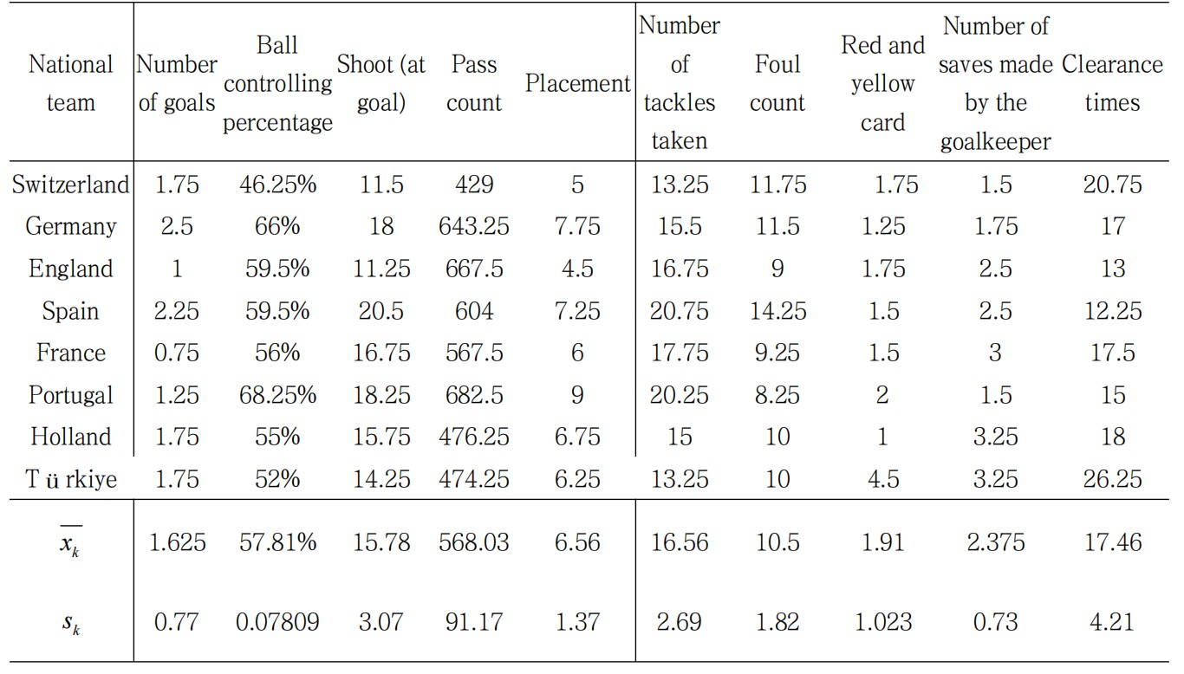
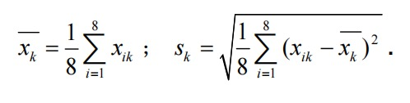
National team data processing steps
Let the field U={x1,x2......x8} represent the sample of 8 teams of the European Cup, and each sample uses 8 idealized indicators to represent its characteristics, that is xi={xi1,xi2,.......xi8},(i=1,2......8). Step 1: Use the shift standard deviation change to analyze the following data table.
Xk is the mean and Sk is the standard deviation

Slide 16
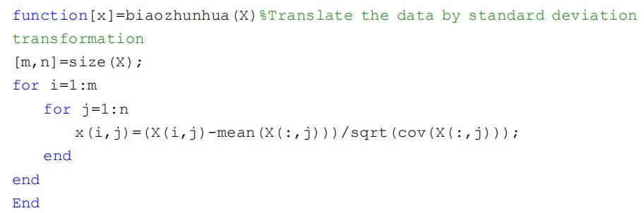
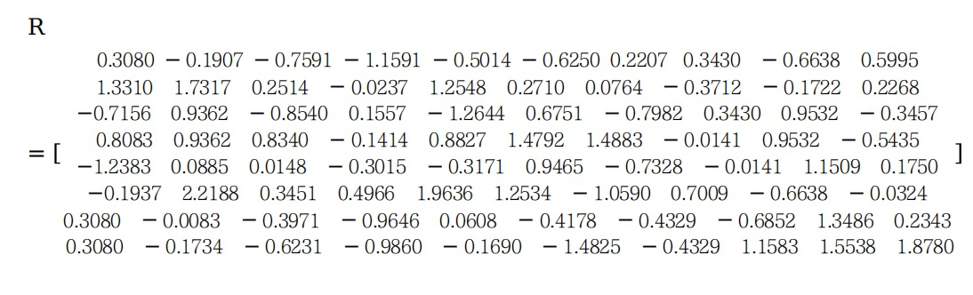
National team data processing steps
Step 2: Data standardization is processed to obtain sample standardization matrix R.

Slide 17
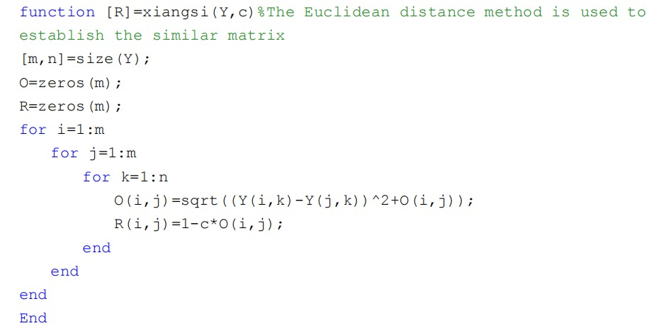
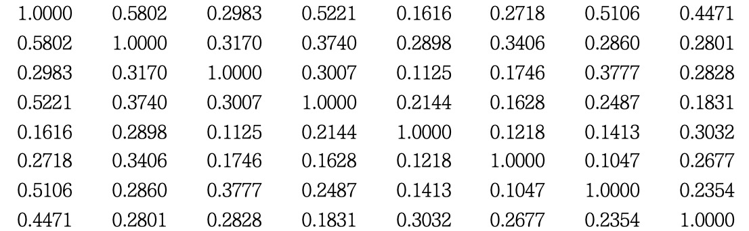
National team data processing steps
Step 3: Using Euclidean distance method to establish a similar matrix R

Slide 18
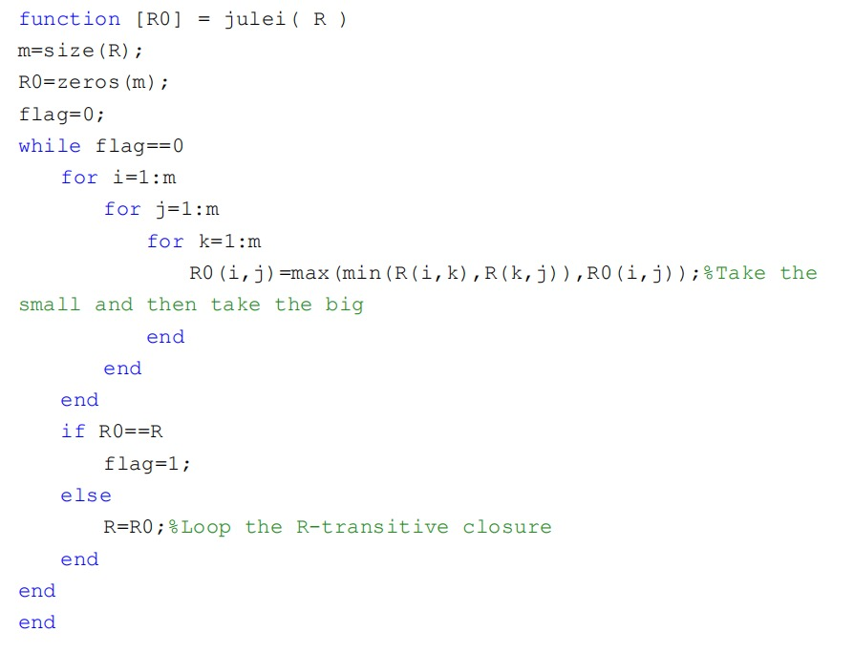
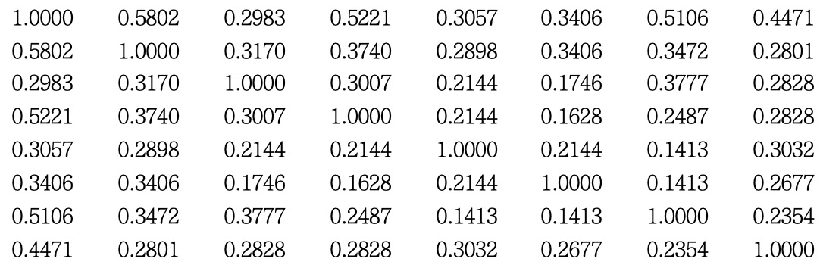
National team data processing steps
Step 4: Step 4: Find its transitive closure matrix through MATLAB

Slide 19
National team cluster analysis
According to the basic idea of fuzzy clustering, according to its transitive closure matrix, k-means algorithm can cluster 8 teams into three Class.
Class 1: England, France, Netherlands;
Class 2: Germany, Spain, Portugal;
Class 3: Turkey, Switzerland;
Predicted results:
Method A: the final four are Germany, England, Portugal and the Netherlands
Method B: First class is England, France, Netherlands
So I predict that this European Championship will be won between England and the Netherlands.
(Of course now we know the result, Spain are champions.)

Slide 20
Limitations of prediction
The data in this report are still limited. The data analyzed in this report are the data of the group stage of this tournament, the European Cup group stage of three + one 1/8 final, a total of four matches, the data is not comprehensive enough to accurately locate a team;
In addition, the player's injury is an unmet factor, the same unforeseeable factors also include natural weather factors, historical clash factors (ditch capsized), unexpected factors, etc., which are difficult to statistics.

Slide 21
The certainty of the prediction
England and the Netherlands, which were predicted using only four matches, did not win the championship but both were in the top four, with England finishing second.
The indicators used in this report will have dimensional effects, and the translation standard deviation change method is adopted in this report to eliminate certain effects and improve the accuracy of data analysis.
In addition, the finals of general football competitions use the knockout format. The analysis objects of this report are all the teams after the group stage, which is a reasonable prediction.

Slide 22
Limitations of prediction
The data in this report are still limited. The data analyzed in this report are the data of the group stage of this tournament, the European Cup group stage of three + one 1/8 final, a total of four matches, the data is not comprehensive enough to accurately locate a team;
In addition, the player's injury is an unmet factor, the same unforeseeable factors also include natural weather factors, historical clash factors (ditch capsized), unexpected factors, etc., which are difficult to statistics.

Slide 23
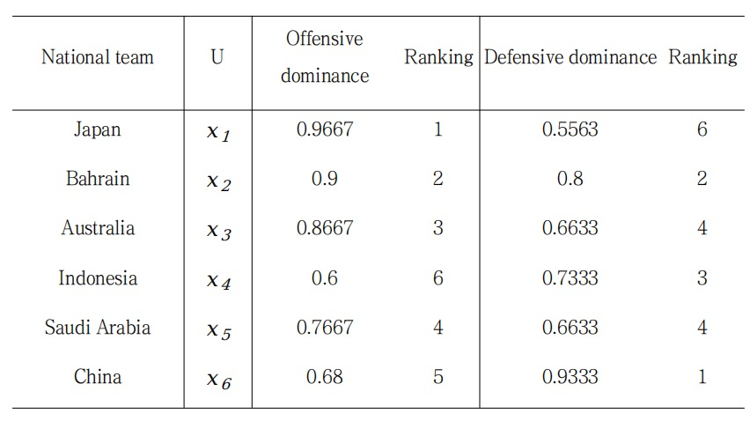
Application of method
Application of fuzzy dominance analysis in the technical adjustment of the 18 World Preliminary matches of the National Football Team in Asia.
Team China entered the Round of 18 Asian qualifiers for the 2026 US-Canada-Mexico World Cup, ending on June 11, 2024, with Team China five
The result was 2 draws, 2 losses and 2 wins, finishing last in Group C.
You can see that the Chinese football team has been defending. Perhaps Chinese football can not use rigid conservative defensive tactics, should learn to flexibly change the formation, on the basis of defense counterattack, perhaps this can be effective

Slide 24
THANKS

